Slide 1
CSS342 Data Structures, Algorithms, and Discrete Mathematics (I)

Slide 2
Goals by the end of this week (10/15, 10/17)
Have a solid understanding about Abstract Data Type
Write your own linked list
With tests
Get comfortable with CMake & Googletest
Textbook “Data Abstraction & Problem Solving With C++”
Study group

Slide 3
Notes on homework 1
Copy constructor

Slide 4
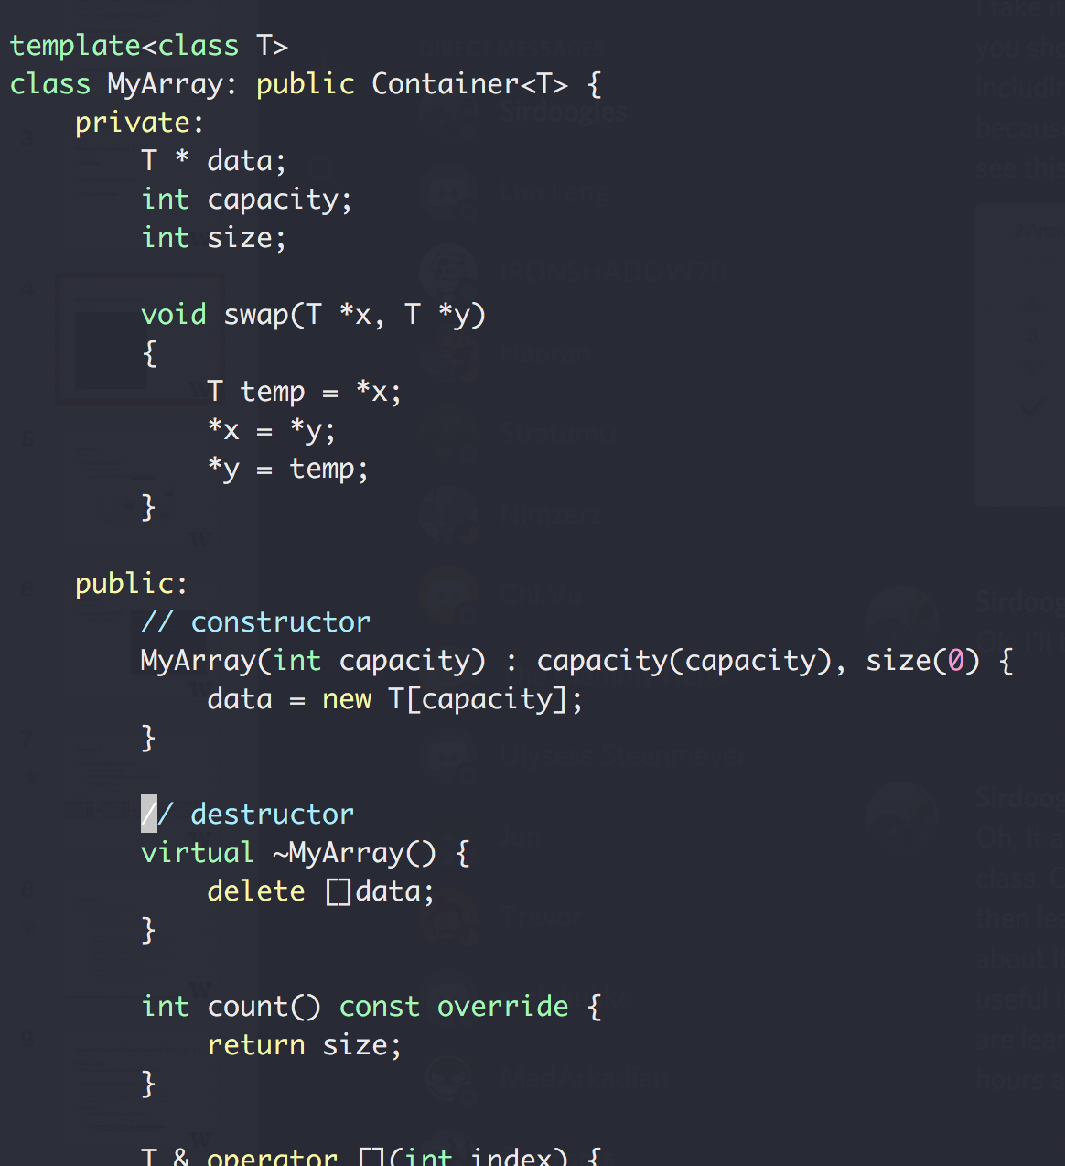
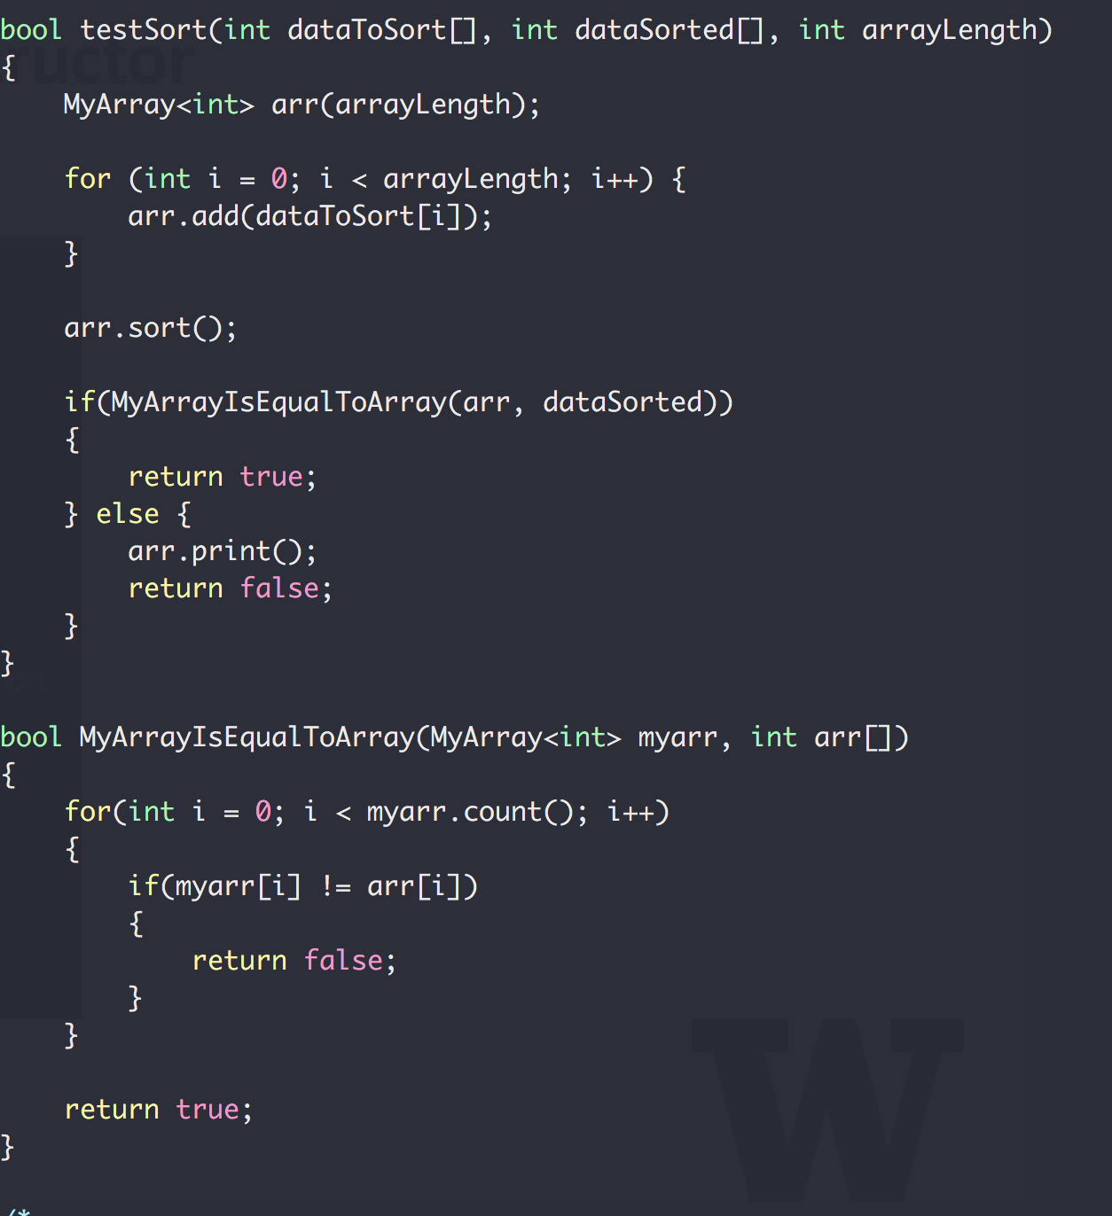
More on Copy Constructor
What’s being passed in?

Slide 5
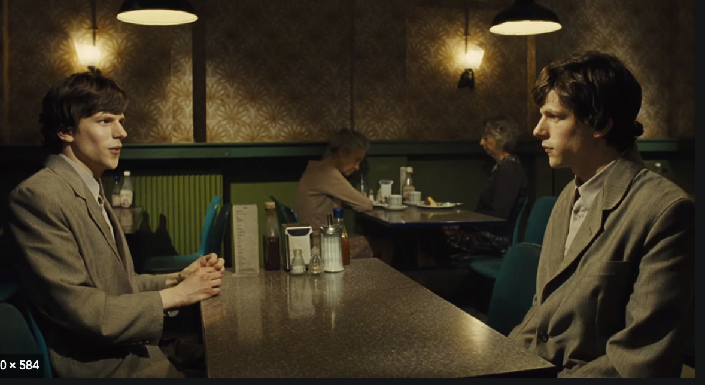
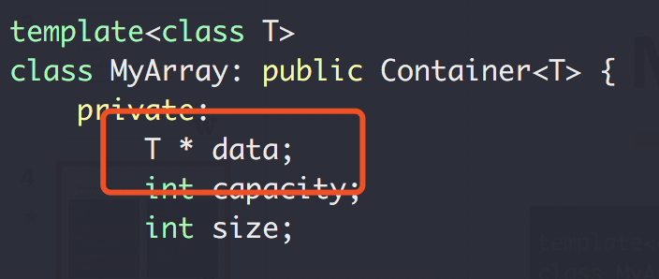
More on Copy Constructor
The copy constructor:
creates an object
initializing it with another object of the same class
Okay, but what if a copy constructor is not defined in a class?
the compiler itself defines one implicitly
Okay, but what if the class has pointer variables and has some dynamic memory allocations?
Array1.data
Data[]
Array1.data
Shallow copy!!

Slide 6
Shallow copy vs Deep copy
Shallow copy: copy the pointer variable only
Deep copy: copy what’s being pointed
See https://www.cs.utexas.edu/~scottm/cs307/handouts/deepCopying.htm
This will be in quiz/exam

Slide 7
C++ Standard Template Library
A powerful set of C++ template classes

Slide 8
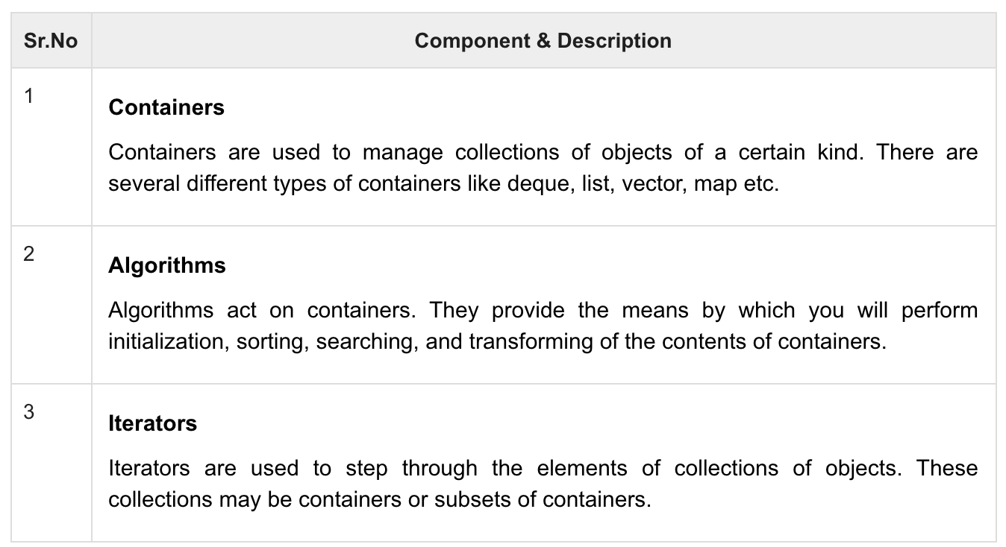
C++ Standard Template Library
A powerful set of C++ template classes
Provide general-purpose classes and functions with templates that implement many popular algorithms and data structures like vectors, lists, queues, and stacks.
https://www.tutorialspoint.com/cplusplus/cpp_stl_tutorial.htm

Slide 9
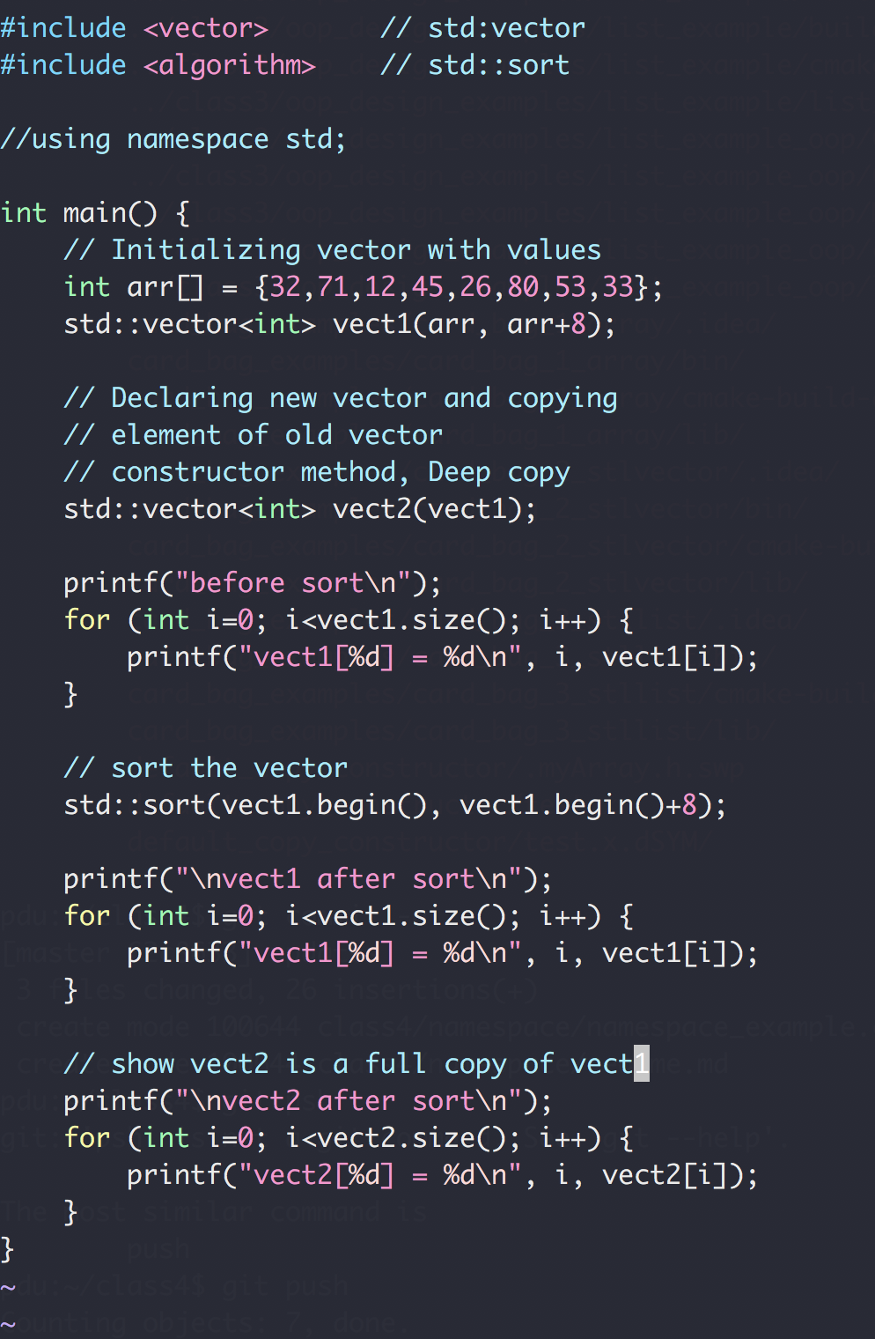
C++ Standard Template Library

Slide 10
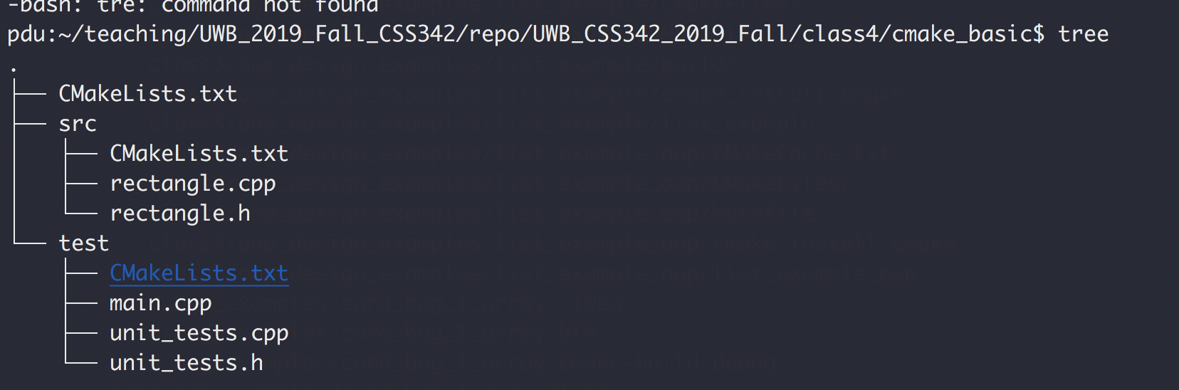
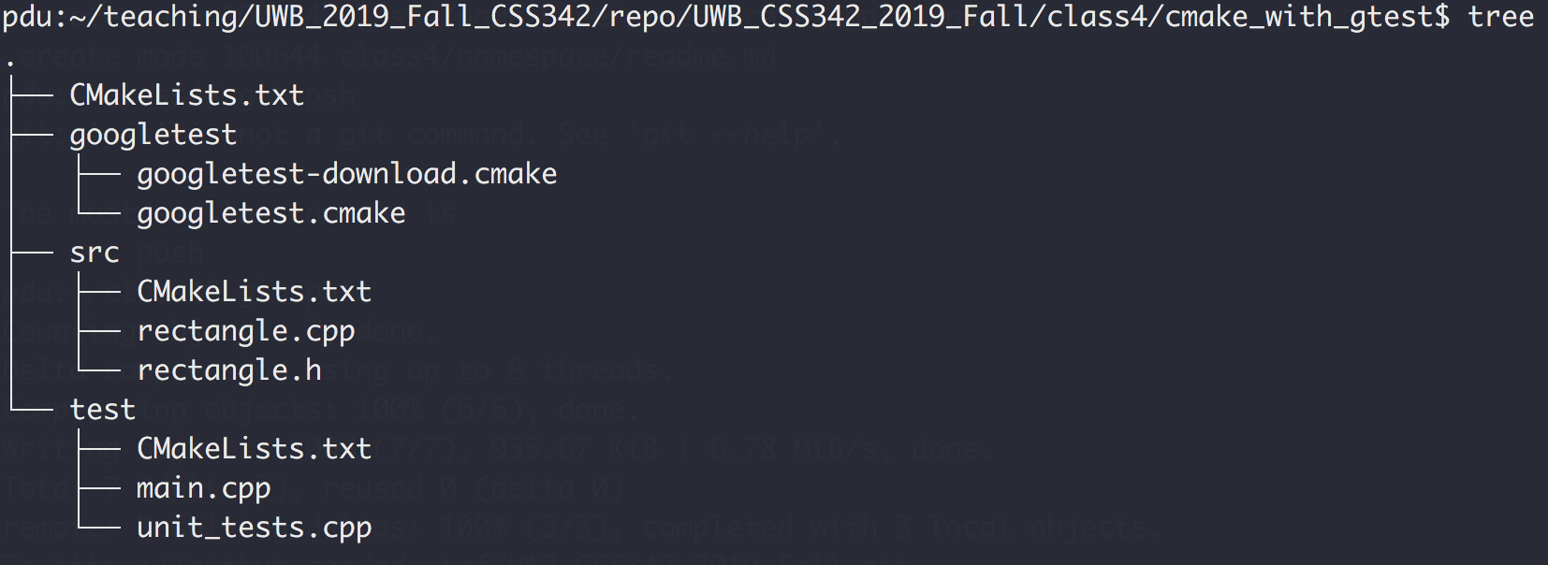
CMake & Googletest
cmake_basic
cmake_with_gtest

Slide 11
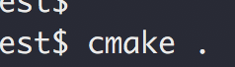
CMake
Create Makefile for you
To run, type:
this will generate all the Makefiles
And then to compile, run ”make” as before

Slide 12
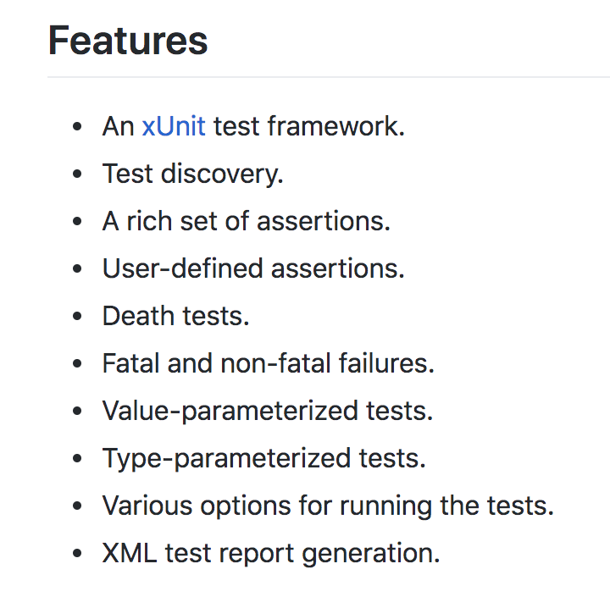
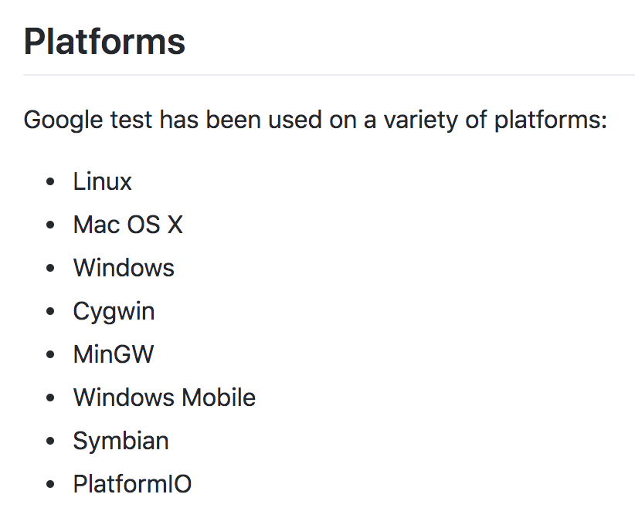
Googletest
https://github.com/google/googletest

Slide 13
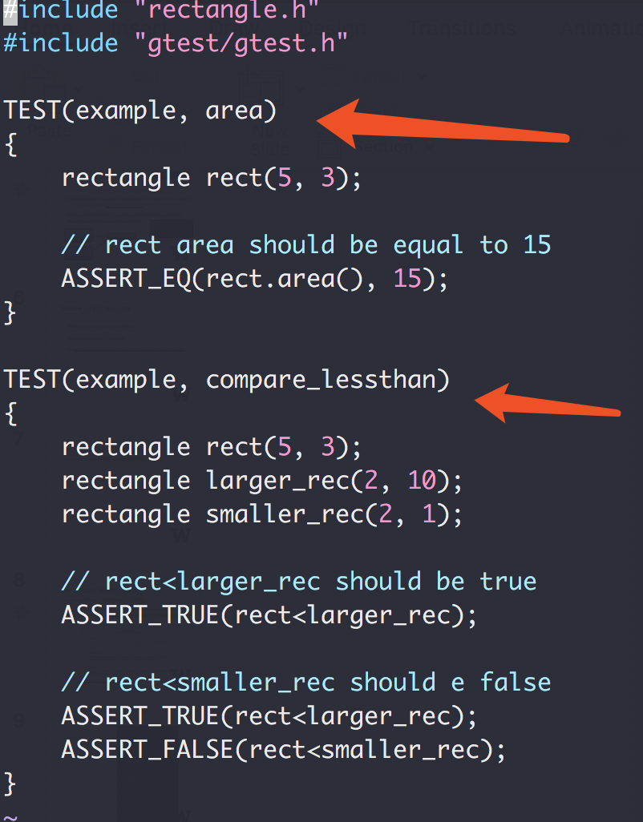
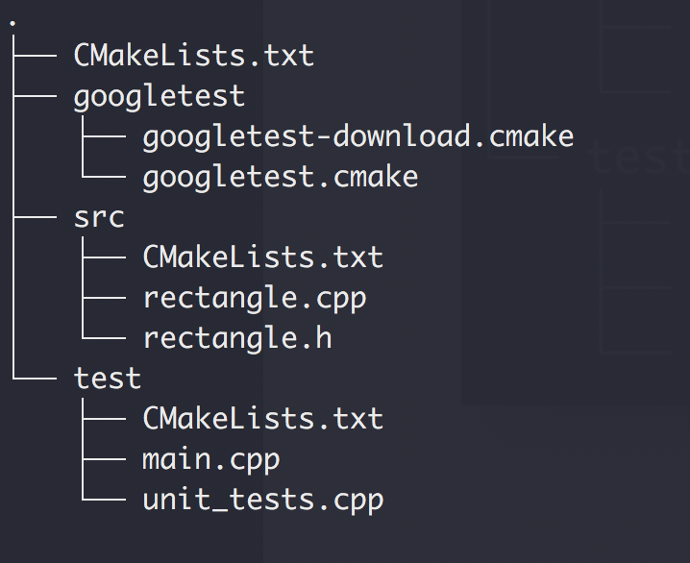
Googletest as our Testing Infrastructure
Our Code Structure

Slide 14
Exercise 1
Design a Stack ADT
First in, last out
Usage: reverse a list, and many others

Slide 15
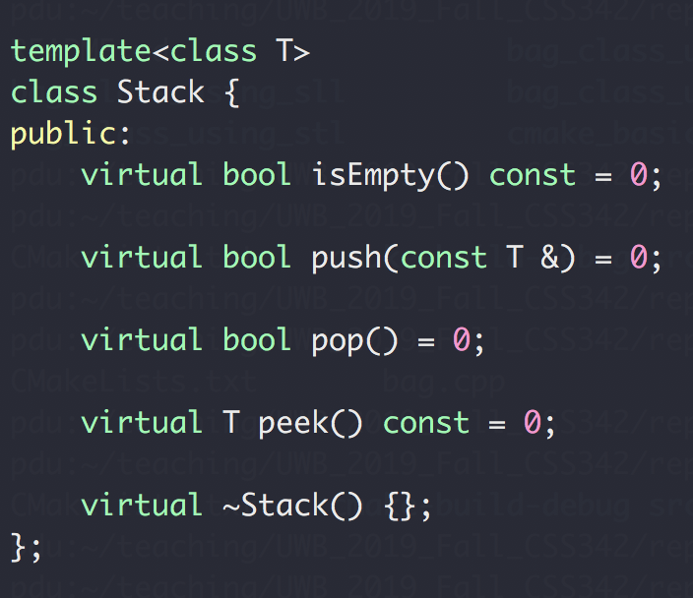
Exercise 1
Design a Stack ADT
First in, last out

Slide 16
Exercise 2
Design a Single Linked List
A collection of nodes
Can only be accesses in a sequential way
No random access
Node
NEXT
NEXT
NEXT
NEXT
end

Slide 17
Exercise 2
Design a Single Linked List
A collection of nodes
Can only be accesses in a sequential way
No random access
prepend(value) : Add a node in the beginning append(value) : Add a node in the end
pop() : Remove a node from the end popFirst() : Remove a node from the beginning
head() : Return the first node tail() : Return the last node
remove(Node) : Remove Node from the list
iterator: iterate through the list
https://medium.com/@lucasmagnum/sidenotes-linked-list-abstract-data-type-and-data-structure-fd2f8276ab53

Slide 18
Abstract Data Type Design
ADT
Interface Design
Implementation
Details

Slide 19
The (modified) ADT Bag (C++ ch 1)
A bag of card of different shape cards

Slide 20
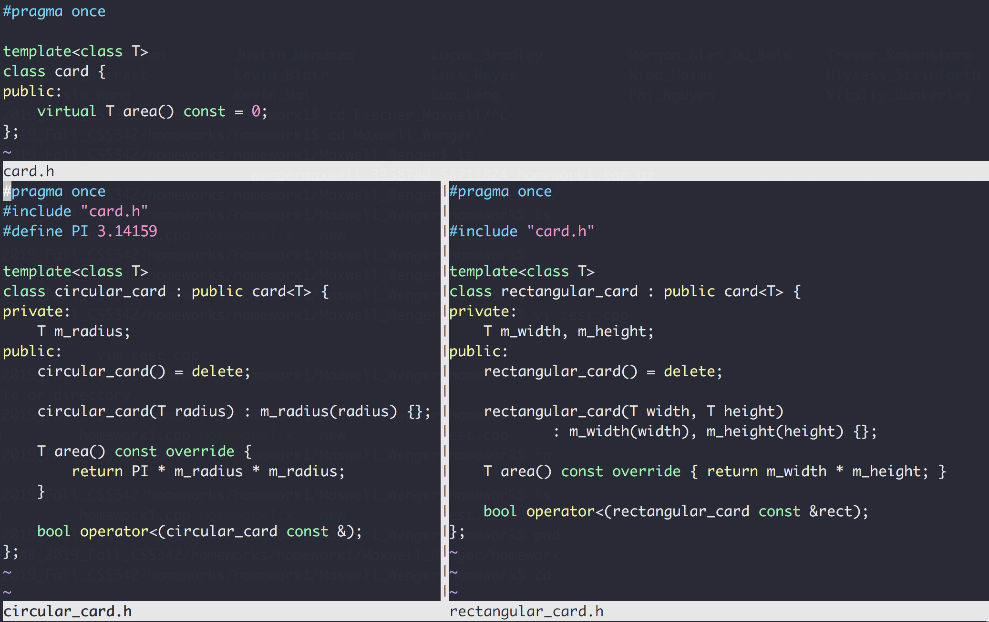
ADT Bag : cards
class card, circular_card, rectangular_card
Base Class
Derived Class
Derived Class

Slide 21
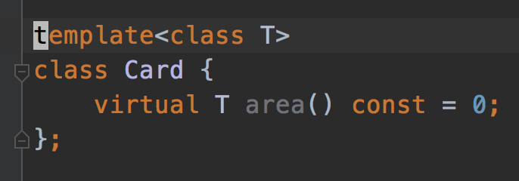
A bag of cards
Design a bag ADT that contains a collection of cards
Cards can be a circular card, rectangular card or any kind that derived from the Card interface
All cards in the same bag will have the same type T

Slide 22
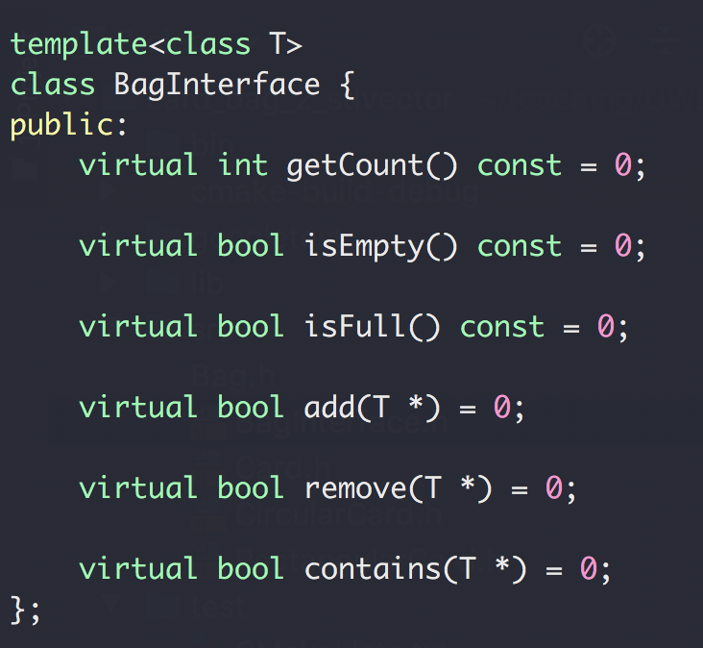
A bag of cards
Interface Design

Slide 23
A bag of cards
Implementation Design
how would you design this based on these card classes

Slide 24
A bag of cards
Data:
A collection of cards
Capacity
Size
Array-based
List-based
Contiguously addressed in memory
Fast random access
Hard to adjust size
Random address in memory
Slow random access
Easy to adjust size

Slide 25
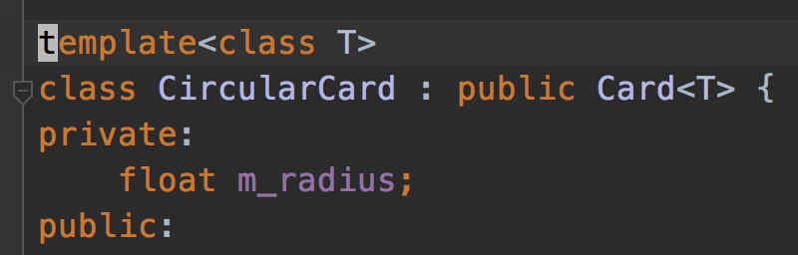
A bag of cards

Slide 26
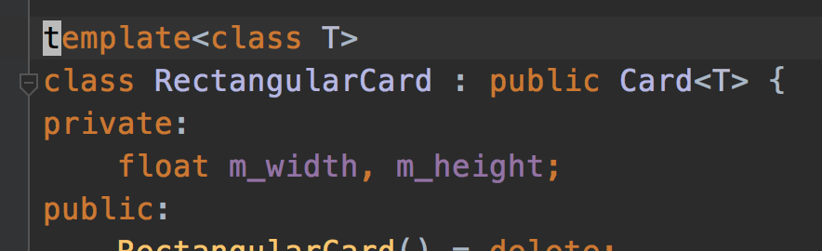
A bag of cards

Slide 27
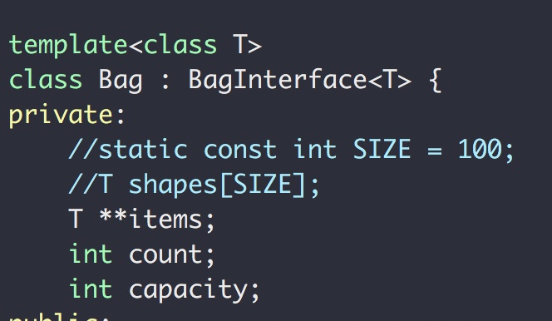
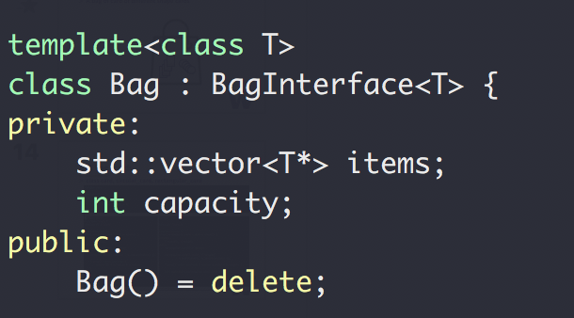
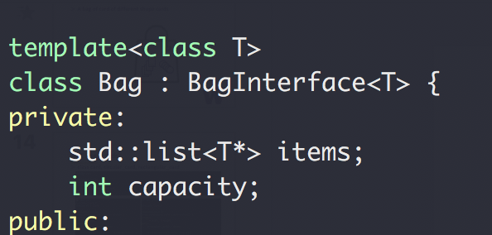
A bag of cards
Array
STL vector
STL list
If you don’t know what “std::” means , see this

Slide 28
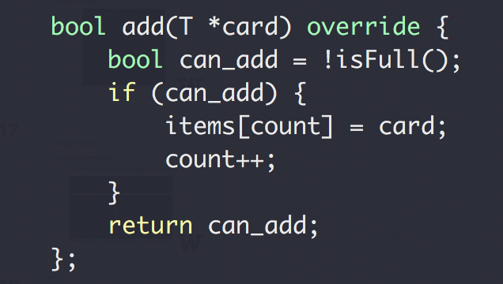
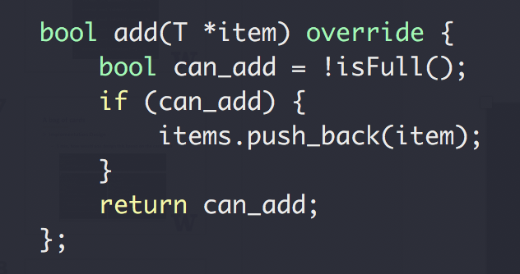
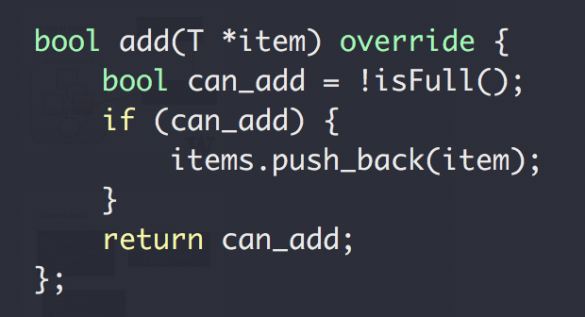
A bag of cards: add()
Array
STL vector
STL list
Same applies to
remove(T *item)
contains(T *item)

Slide 29
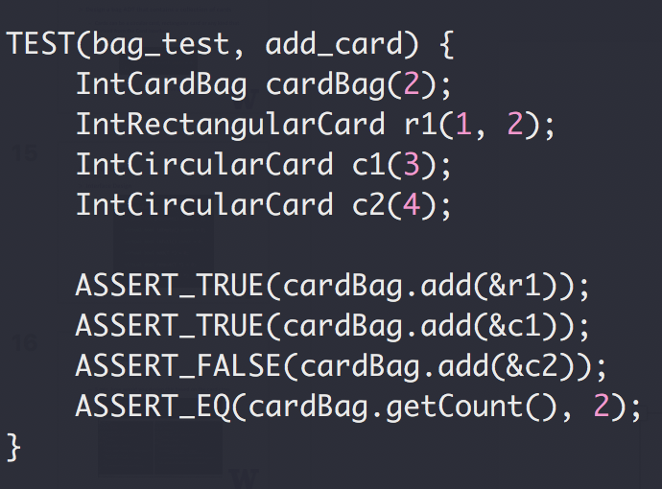
A bag of cards
From testing (user) perspective:
What did we change in test for each storage type (array, vector, list?)
Nothing! All test codes are exactly the same!

Slide 30
A bag of cards
Summary
Same interface
Different implementation
Same test code
Next up
Replace std::list with our own singly linked list

Slide 31
Abstract Data Type Design
The (modified) ADT Bag (C++ ch 1)
Interface
Implementation (storage option)
Storage option
Array based (C++ ch3)
C++ array (primitive array) , or
C++ Standard Template Library array(vector)
List Based (C++ ch4)
C++ Standard Template Library array(list), or
Our own singly linked list (SLL)
And once we have our own SLL
Stack
Queue
… next week

